Slide 1

Modelling Perceptual Decision Making: the Drift Diffusion Model
Jaime de la Rocha
Brain Circuits and Behavior Lab, IDIBAPS
Slides are based on previous lectures by Alfonso Renart and Anne Urai

Slide 2
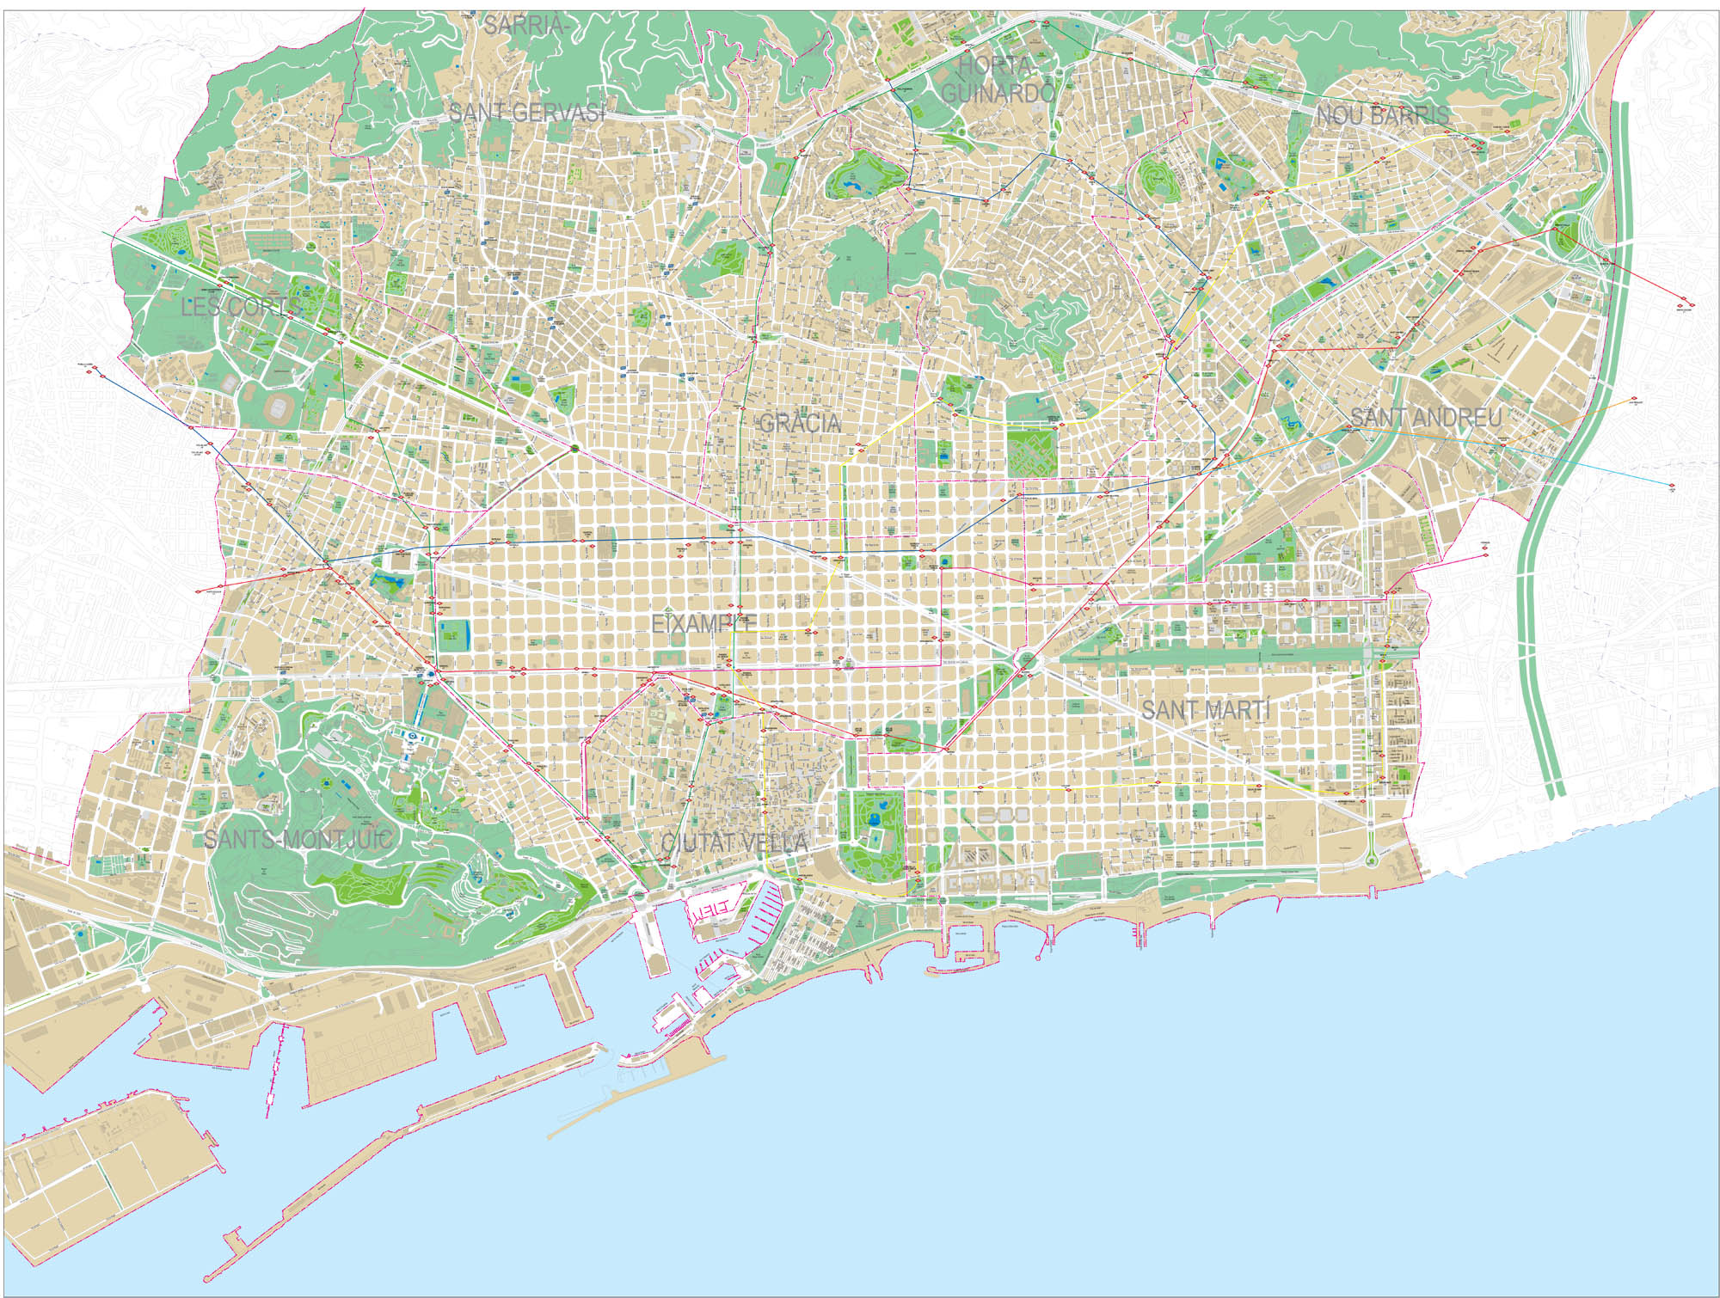
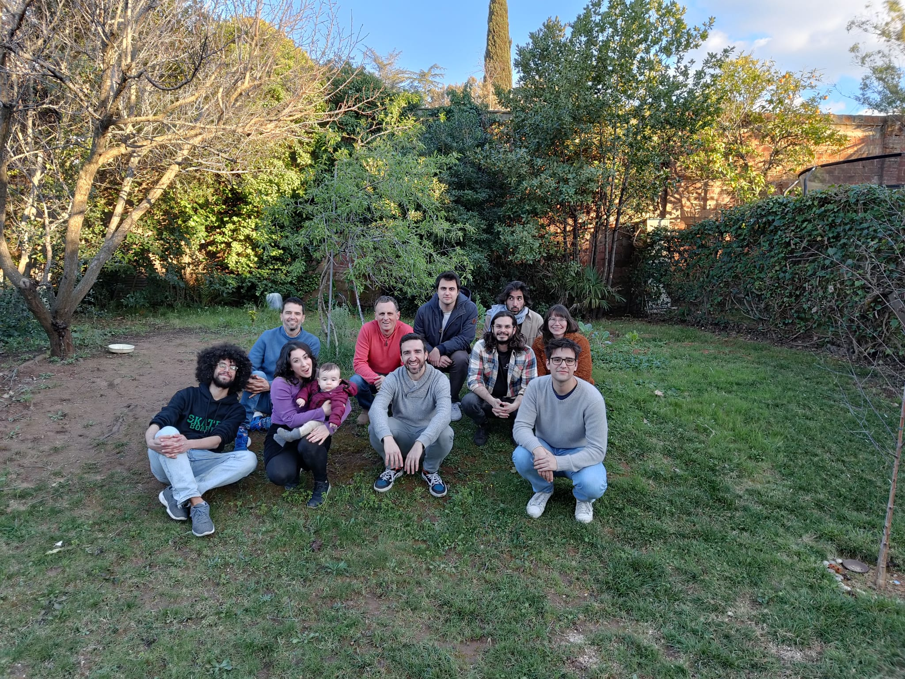
Brain Circuits and Behavior Laboratory IDIBAPS, Barcelona

Slide 3





1st BioRTC – Simons Comp. Neuro. Course
Organized by A. Compte and M. Marvall

Slide 4
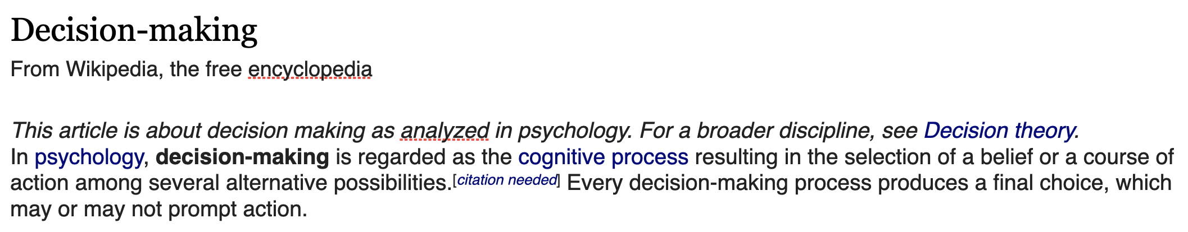
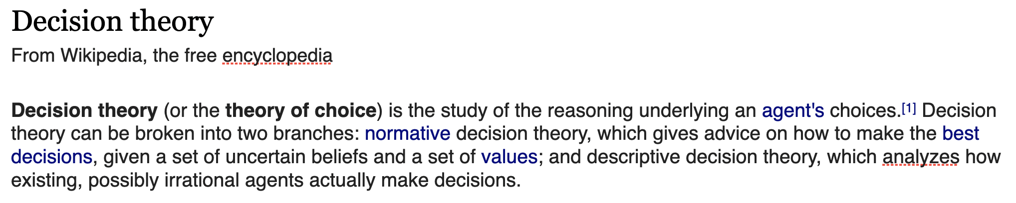

What is a decision?

Slide 5

What is a decision?
It will be fun.
The students from the BioRTC course will love it.
I look good!
Come dressed as a Nigerian
?
Students won’t take my class very seriously.
BAMB organisers won’t invite me again
People will say that is “cultural appropriation”
I’ll sweat like a pig
Come dressed as a western
Decision-making: The exercise of (causal) agency
To study it experimentally we need a situation where, given the
environment, there is uncertainty as to which action to select.
Deciding will imply the resolution of that uncertainty by
some process inside the brain’s agent.

Slide 6
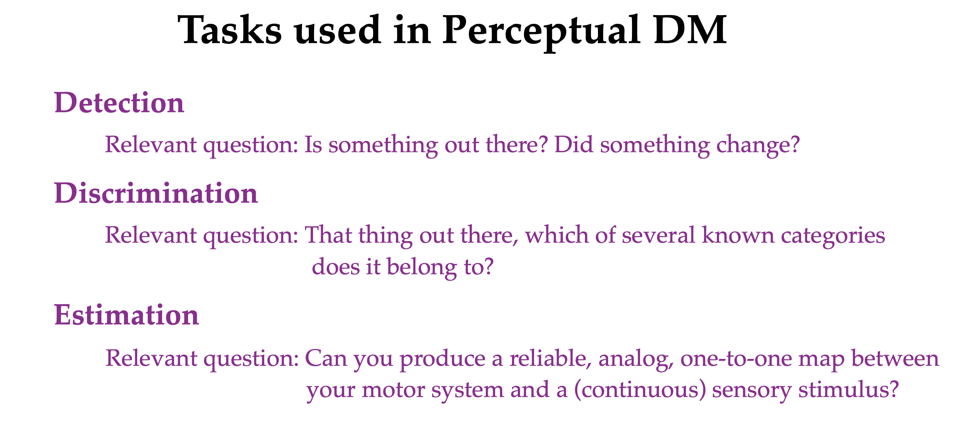
Detection and Discrimination involve ‘categorical choices’ and have been typically conceptualised as forms of hypothesis testing. Common in human and non-human primates and other species.
Estimation involves ‘analog choices’ and is more related to statistical parameter estimation. It is also more sensitive to sensory-motor calibrations. Commonly restricted to human and non-human primates.

Slide 7
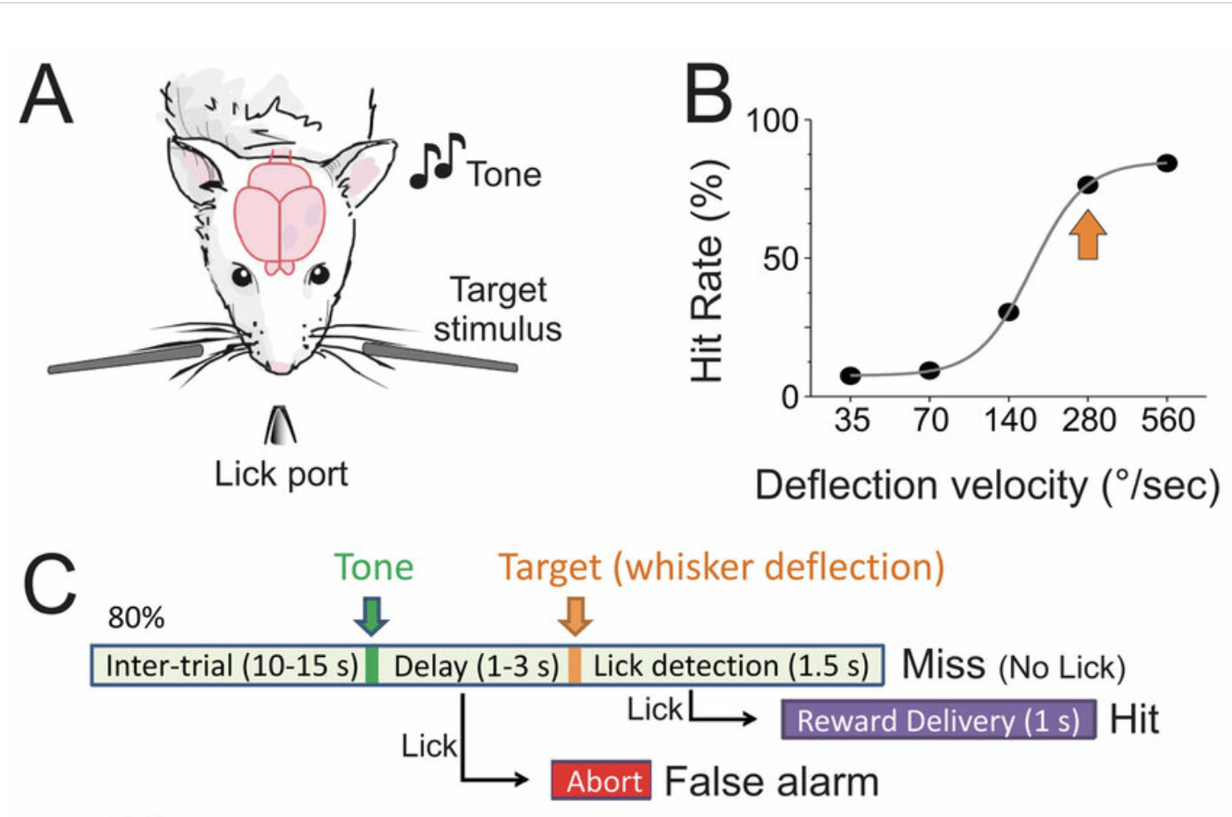
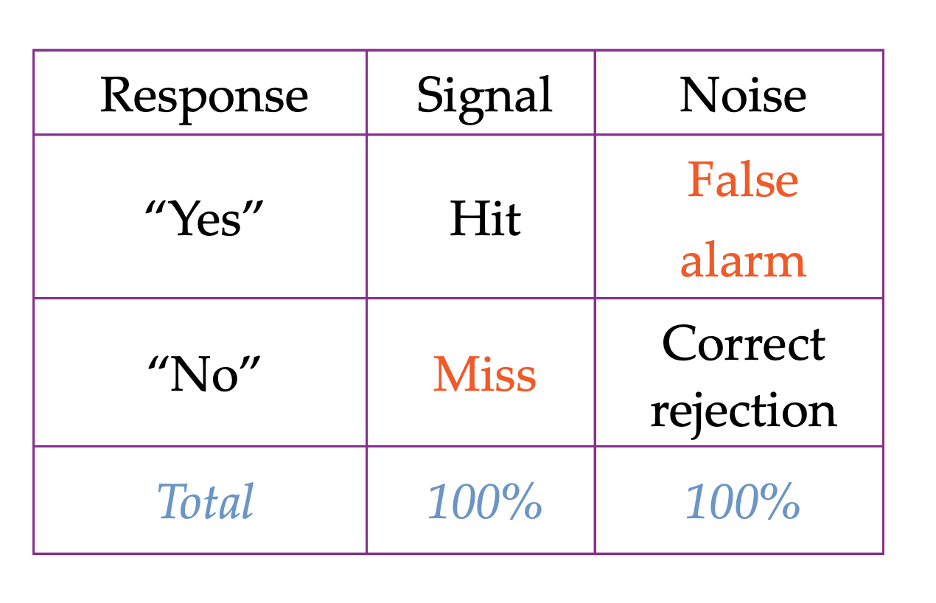
Example of a detection task in rodents
No signal
Because columns sum to 100%, only 2 independent numbers.
The convention is to use hits (H) and false alarms (FA)

Slide 8
Behavior in H-FA plane
Good
Performance
Responsive
Subject
1
Prob. Hit
Unresponsive
Subject
Random
Choices
0
0
1
Prob. False Alarm

Slide 9
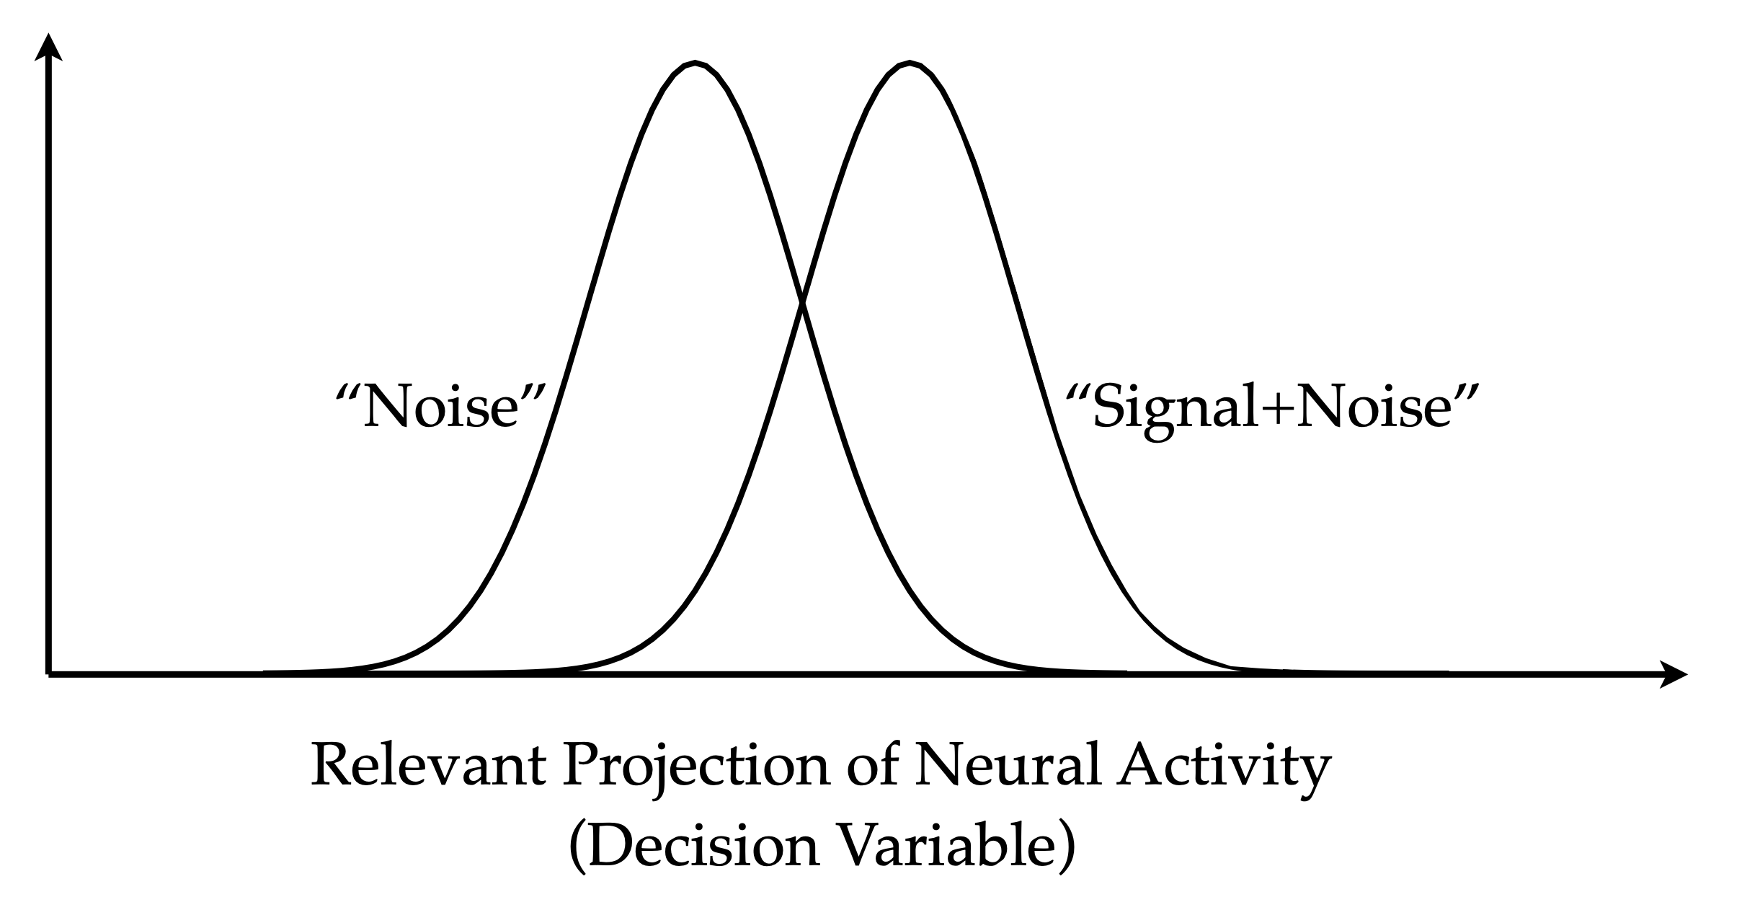
Signal Detection Theory (SDT)
The “sensory” aspect of the problem refers to the ability to distinguish these two distributions
Tanner and Swets, Psychological Review 1954

Slide 10
Signal Detection Theory (SDT)
The “decision” aspect of the problem has to do with defining a criterion that maps the ‘decision variable’ onto an action.
criterion
Tanner and Swets, Psychological Review 1954

Slide 11
Signal Detection Theory (SDT)
criterion
False Alarms
Tanner and Swets, Psychological Review 1954

Slide 12
Signal Detection Theory (SDT)
Hits
criterion
Tanner and Swets, Psychological Review 1954

Slide 13
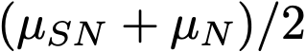
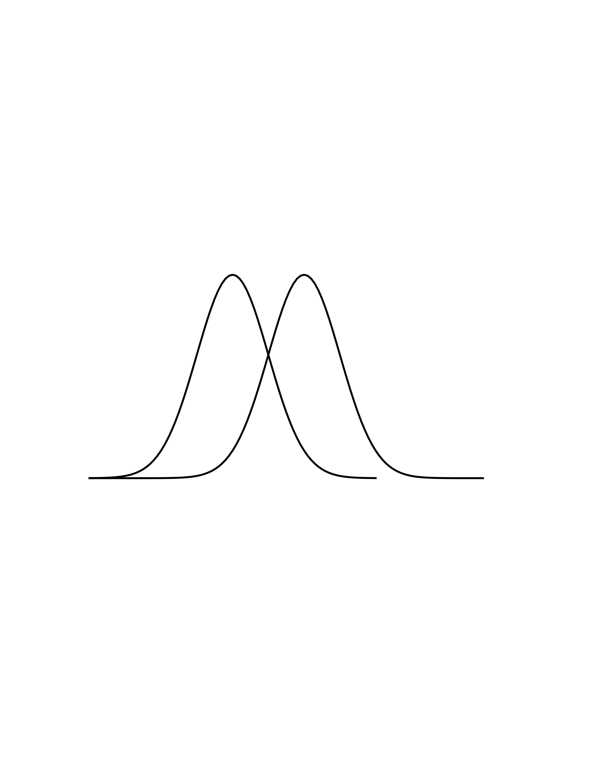

Parameters in SDT: d’ and Bias
Noise+Signal
Noise
Bias
d’
d’ is supposed to represent the true measure of discriminability for a given stimulus strength. It is independent on the subjects strategies.
The criterion c (bias) sets the response tendencies of the subject and can vary depending on various factors such as prior probability of stimulus occurrence, pay-offs, etc…

Slide 14
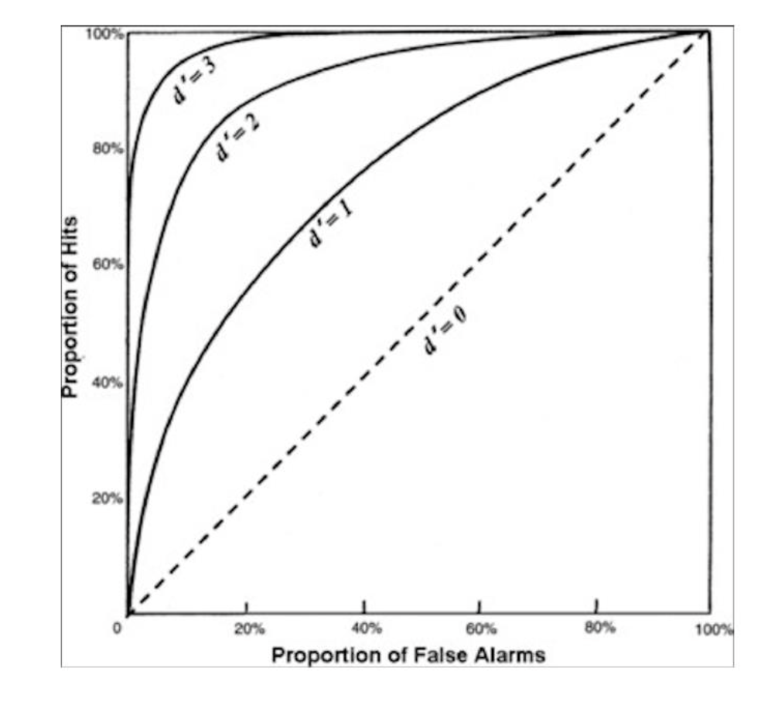
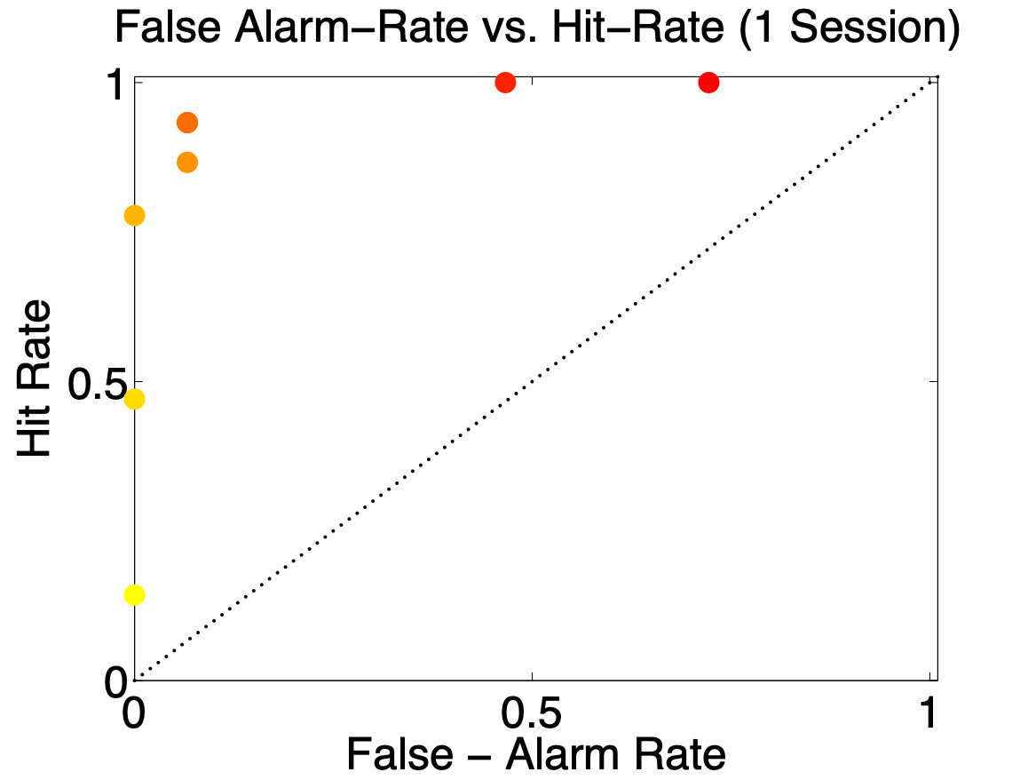
Manipulating the Criterion. The ROC curve.
(unintended) Value manipulation
c
c
Early in the session
Late in the session
Detection tasks suffer from changes in the criterion (motivation, impulsivity, etc).
The are under the ROC curve (AUC) provides a normalized (criterion independent) measure of sensitivity

Slide 15
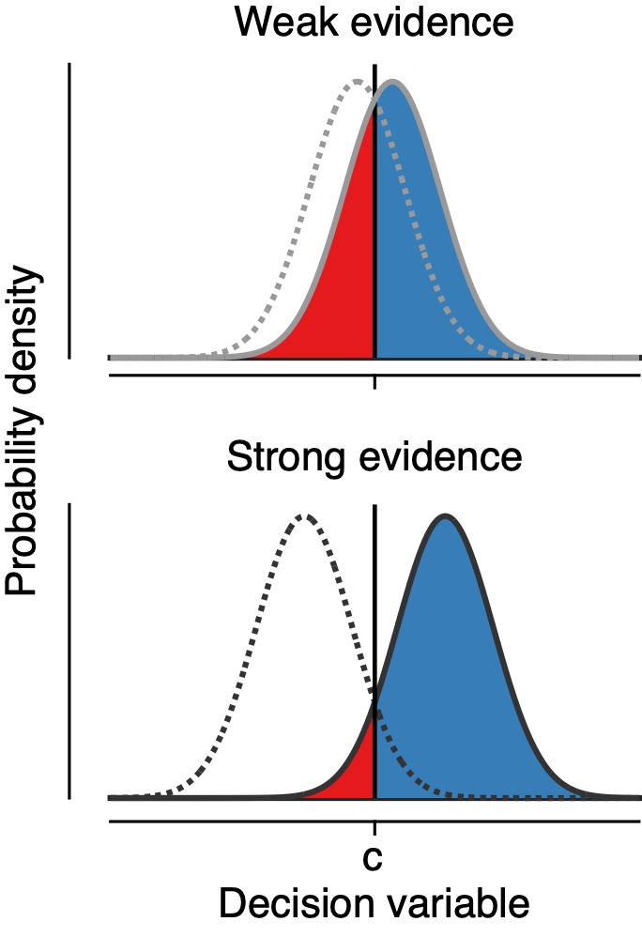
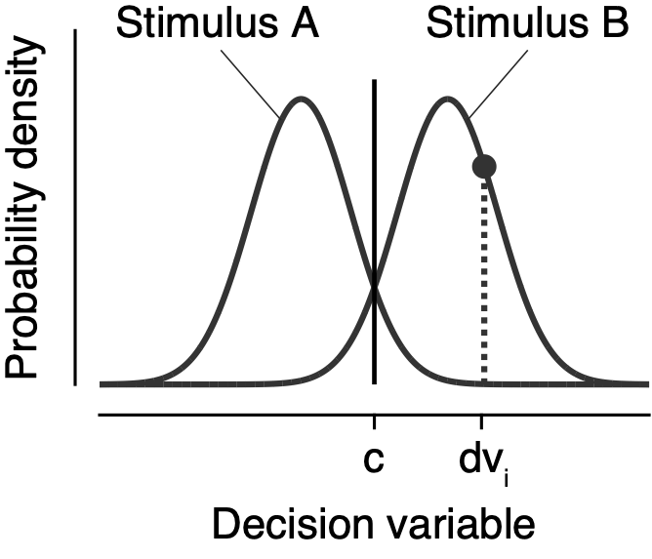
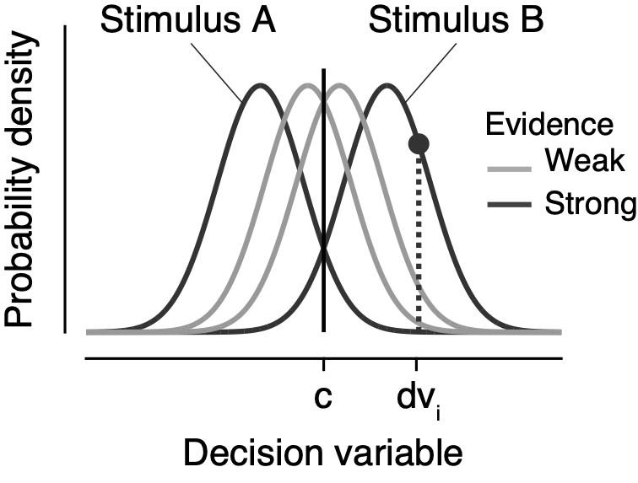
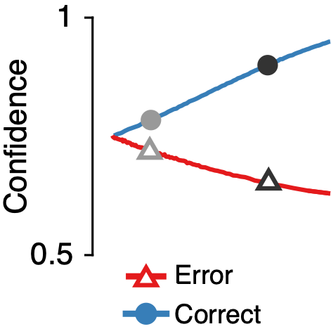
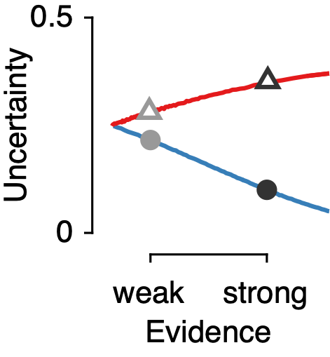

Decision confidence
Stimulus A
Stimulus B
Choice_{i} = sign(x_{i} – c)
Confidence_{i} = f(|x_{i} – c|)
error
correct
Decision variable x
Notes:
definition of decision uncertainty derived from SDT.
Confidence is a monotonic function of the distance between dv and c (sigmoid)

Slide 16
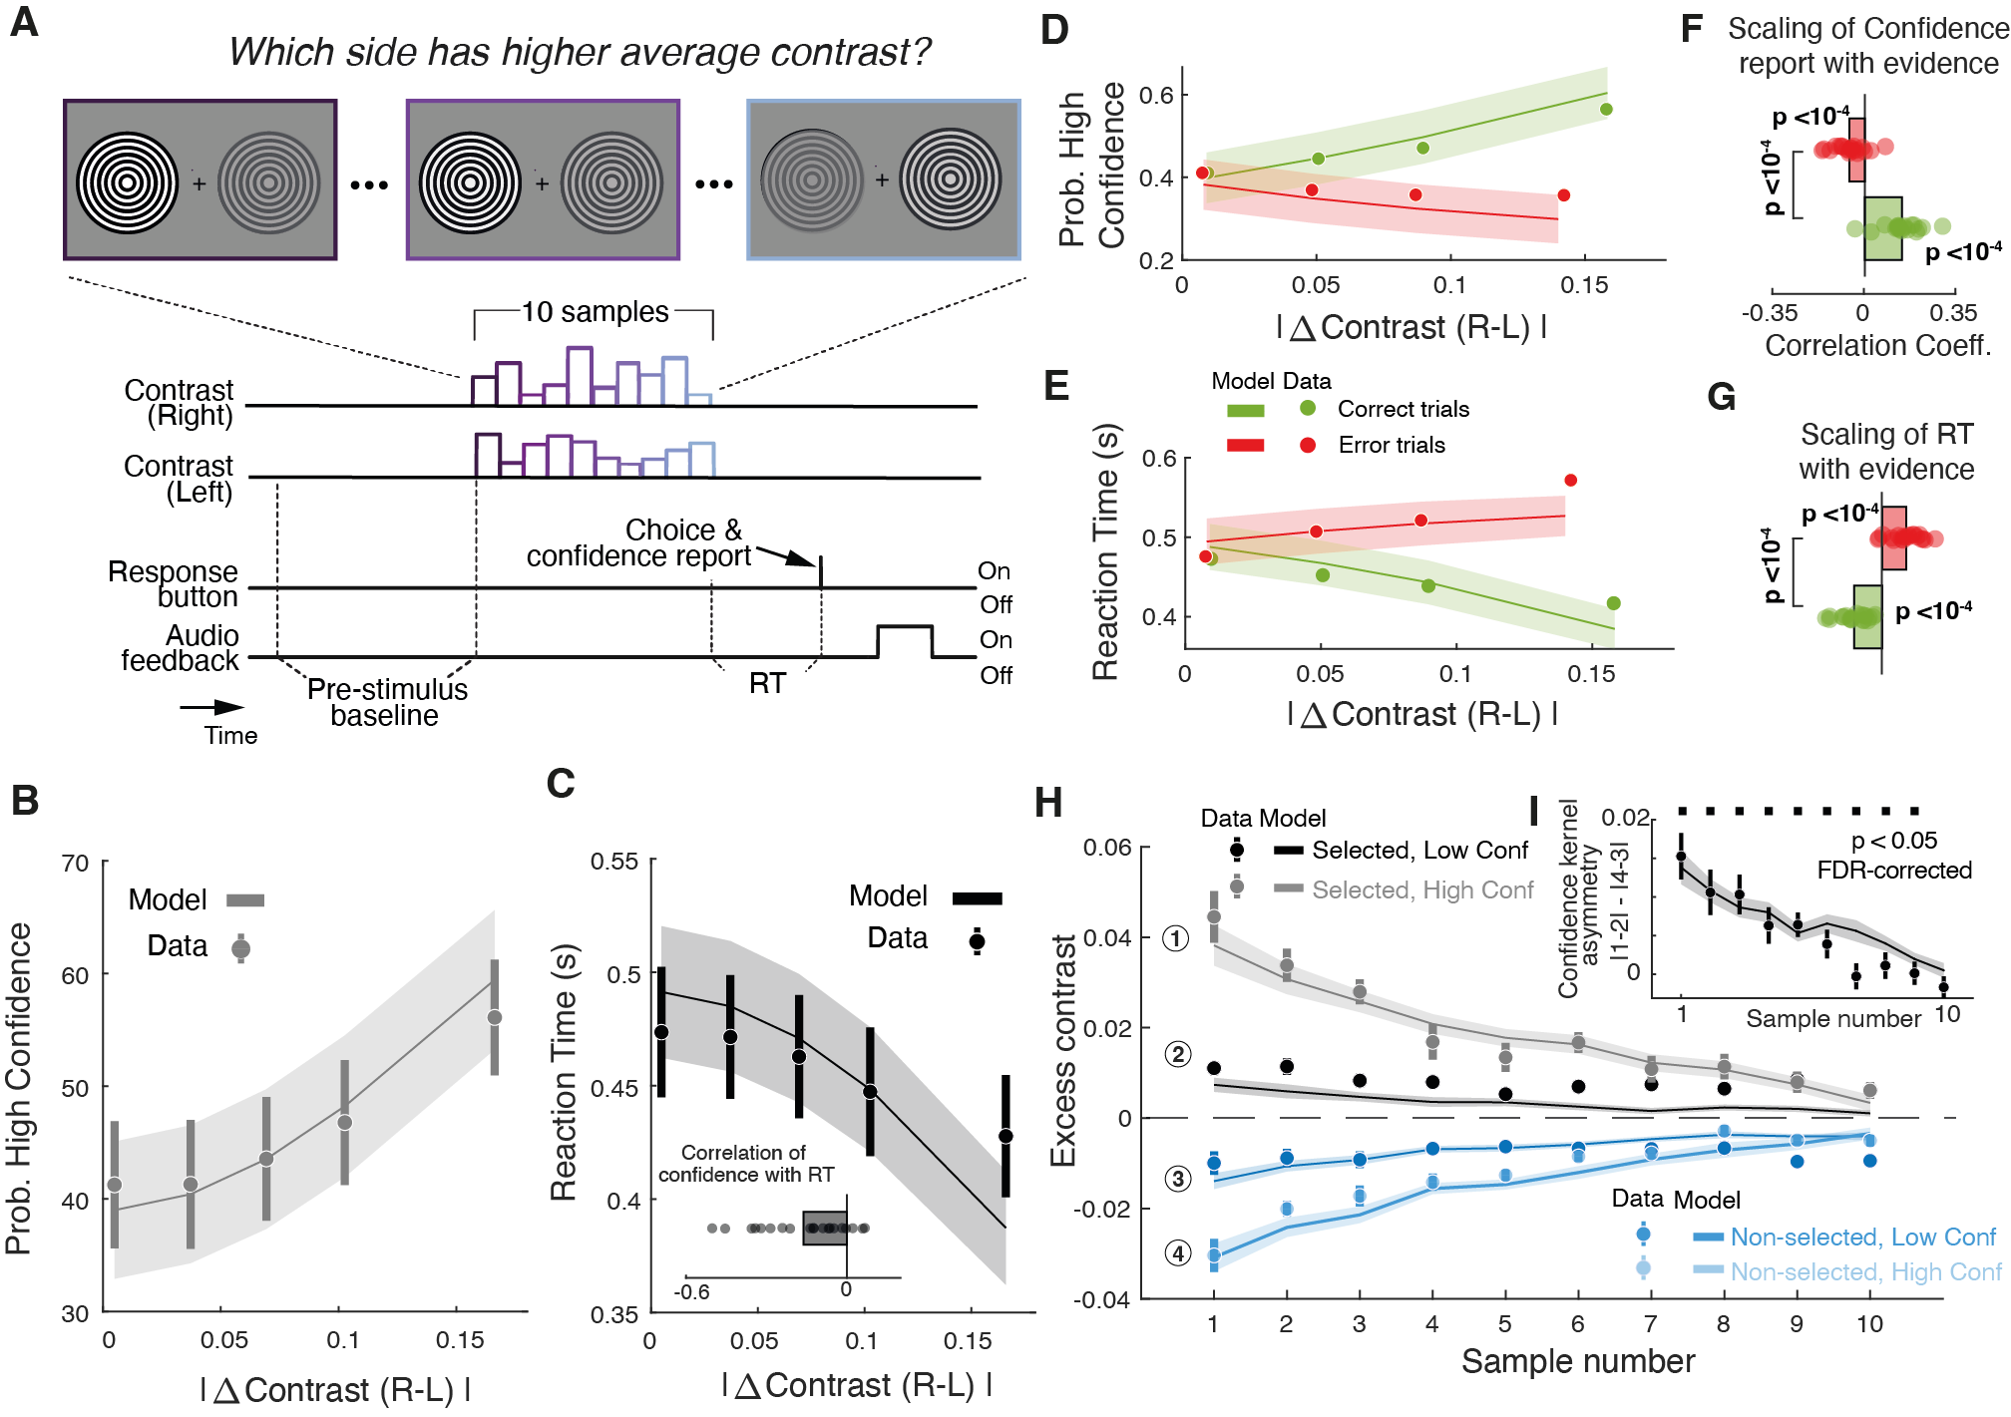
Decision confidence
Tosso et al (2025)

Slide 17
Detection vs Discrimination
Same treatment in SDT (Noise=Stim1 ; Signal+Noise=Stim2).
Critical difference: in Detection, the task-relevant axis is ‘DC’ (more vs less overall neural activity). In Discrimination, the task-relevant axis is ‘differential’ (difference in activity between relevant neural channels)
Discrimination is more robust to unspecific noise sources and overall tendencies to response
Notes:
Discrimination (~ common mode rejection).

Slide 18
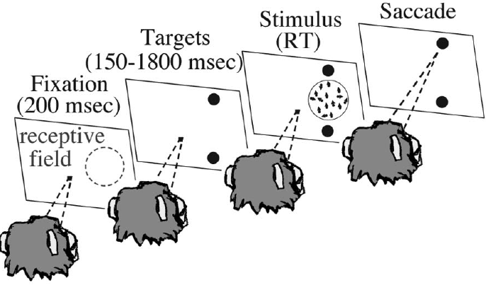
Motion discrimination task
Forced choice between two categories (e.g. LEFT vs. RIGHT motion).
Variable stimulus duration (= RT): animal decides how long it watches the stimulus before responding.
Rewarded for correct responses.
Newsome et al., 1989; Britten et al 1996; Shadlen et al 1996; Zohary et al 1994;

Slide 19
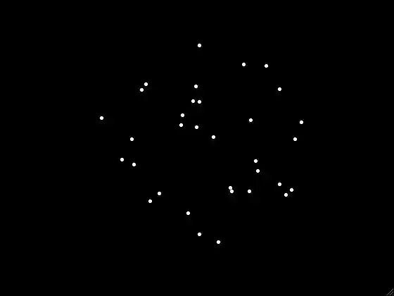
Motion discrimination task
Coherence = 0.5

Slide 20
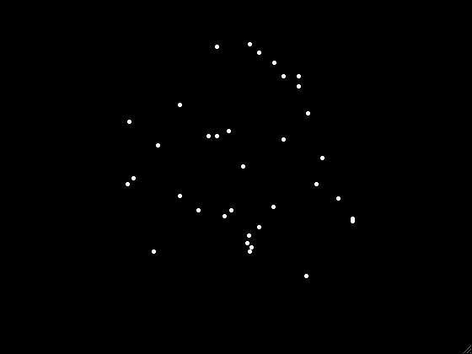
Motion discrimination task
Coherence = 0.1

Slide 21
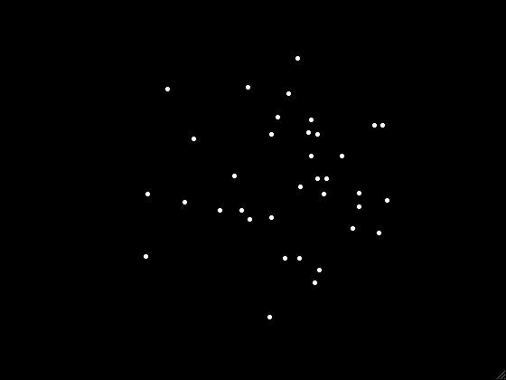
Motion discrimination task
Coherence = 0

Slide 22
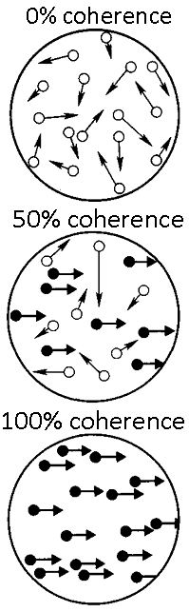
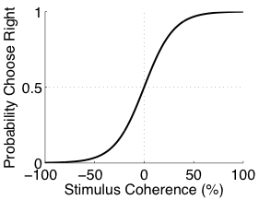
Motion discrimination task
c = 30 %
coherence = -100 %
0 %
5 %
100 %

Slide 23
Outline
Signal Detection Theory
Sequential Probability Ratio Test (SPRT)
Drift Diffusion Model (DDM)
Applications and extensions of the DDM.

